Slide 1
TEAM NAME CYBER WIZARDS
TEAM MEMBERS:
N RISHI RAJ REDDY
J SAIKUMAR
D V S N UMA SWETHA
CH CHANDRA MOULI
D S L SATYA PRIYA
N PAVAN

Slide 2

THE BINARY PROJECT

Slide 3
PROBLEM STATEMENT:
Graphical Password Authentication
ORGANIZATION:
AICTE (All India Council for Technical Education)

Slide 4

Password :
cyberwizards@12345mn

Slide 5
Password :
**************

Slide 6


What was my password?
Password :

Slide 7
Password 1 :
cyberwizards123
Password 2:
@#yukjbfeb@731
Password 3:
Ui2345H@8*3254545

Slide 8

Website 1
Password 1 :
cyberwizards123
Website 2
Password 2:
@#yukjbfeb@731
Password 3:
Ui2345H@8*3254545
Website 3

Slide 9
Password 1 :
cyberwizards
Password 2:
cyberwizards
Password 3:
cyberwizards
Same Passwords For Different Websites

Slide 10

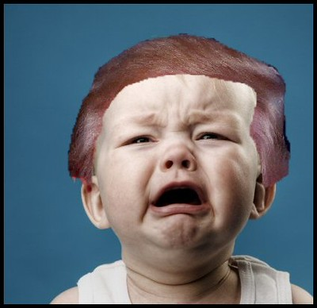
Website 1
cyberwizards
Website 2:
cyberwizards
Website 3:
cyberwizards
All accounts with same passwords hacked !!

Slide 11
Brute Force Attack
Password Leaked!!
Password :
cyberwizards@12345mn
Dictionary Attack

Slide 12
GRAPHICAL PASSWORD
AUTHENTICATION

Slide 13
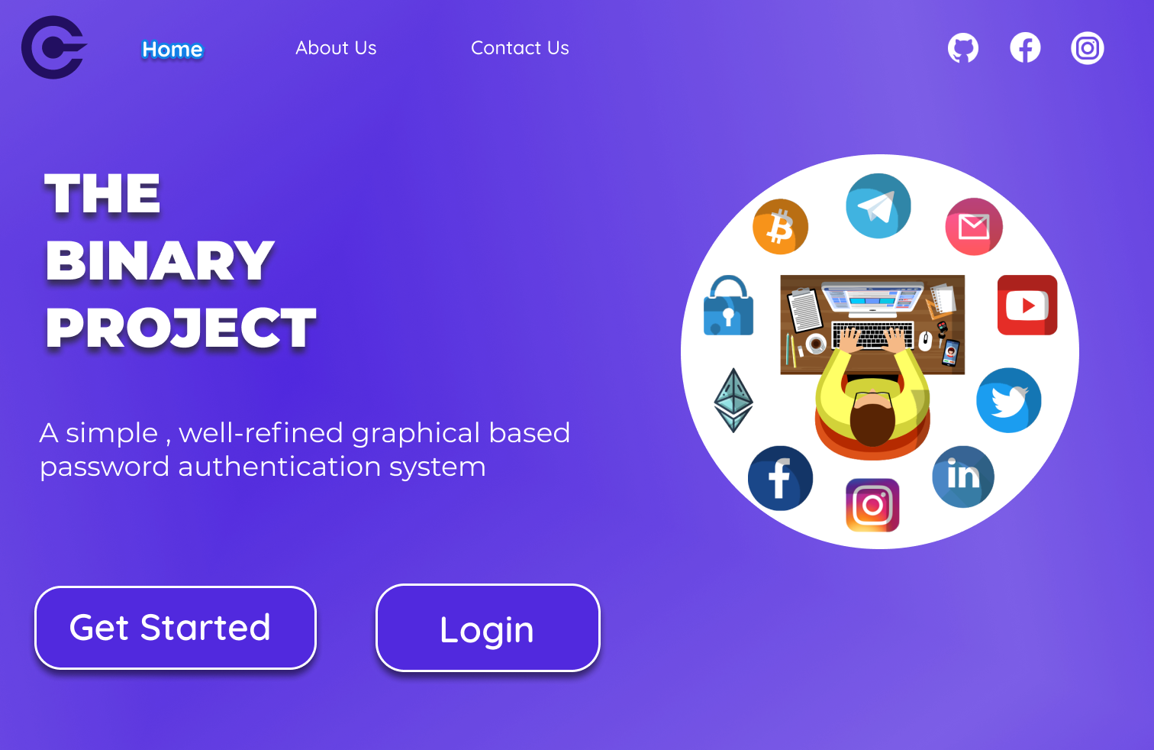
HOME PAGE

Slide 14
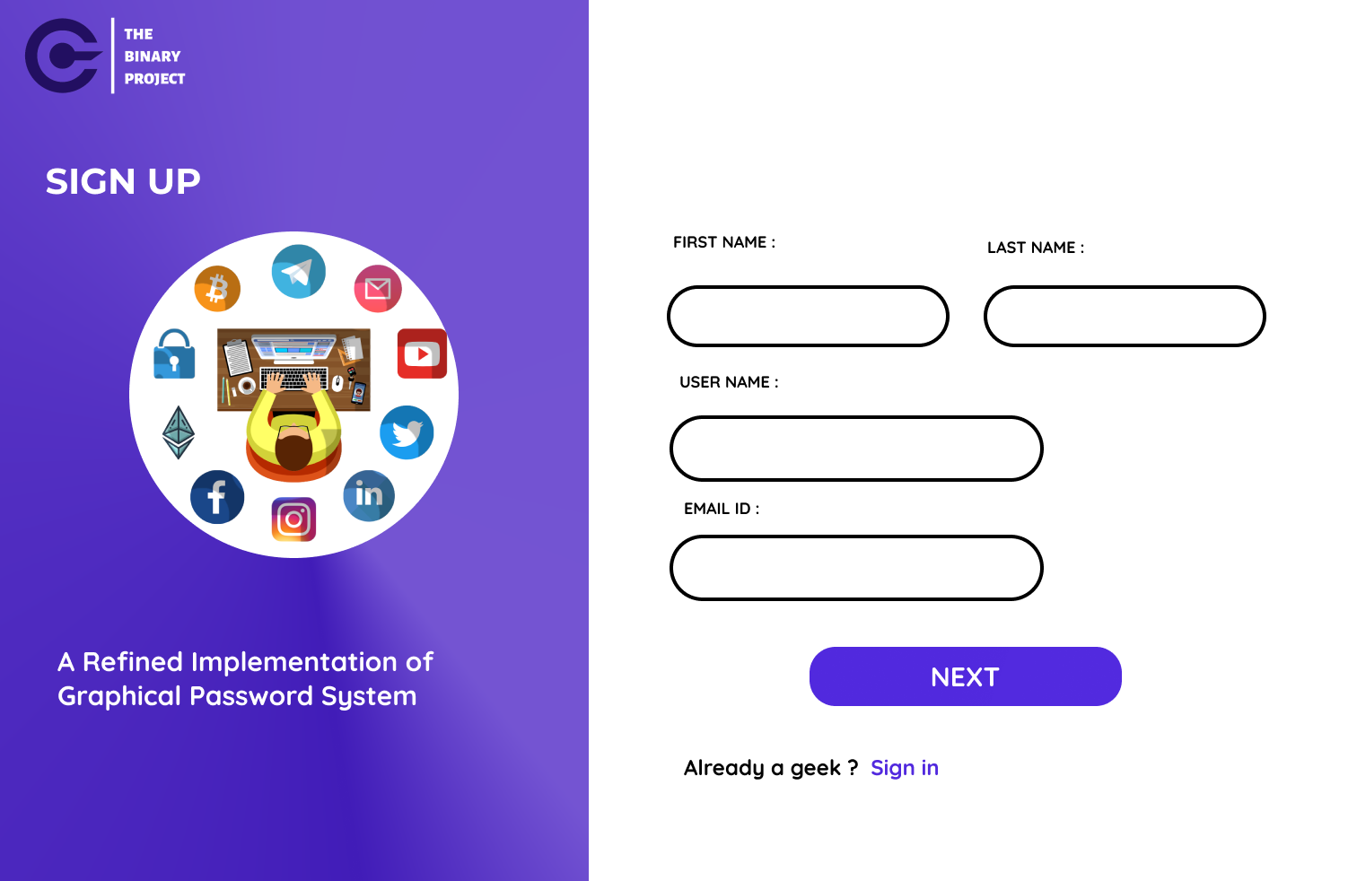
SIGN UP
Nebarthi
Pavan
cyberwizard7
cyberwizard@gmail.com

Slide 15
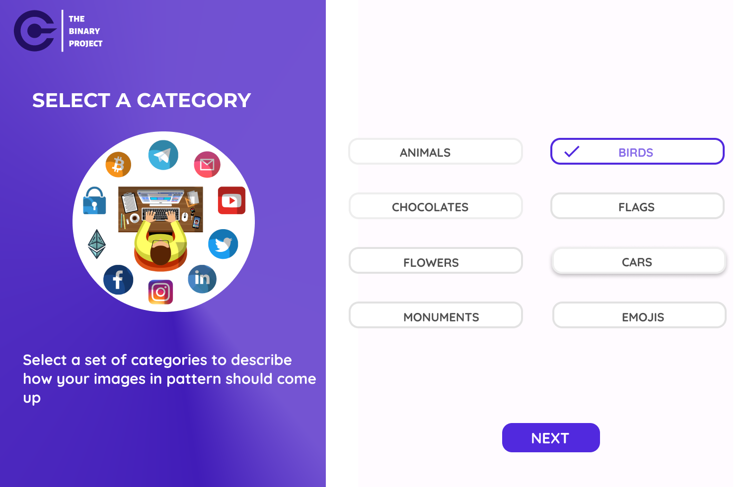
SIGN UP – Select a category

Slide 16

DEEP IMAGE SEARCH

Slide 17


DEEP IMAGE SEARCH

Slide 18
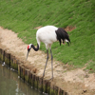

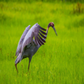

Selected Image
Similar Images
Deep transfer learning

Slide 19
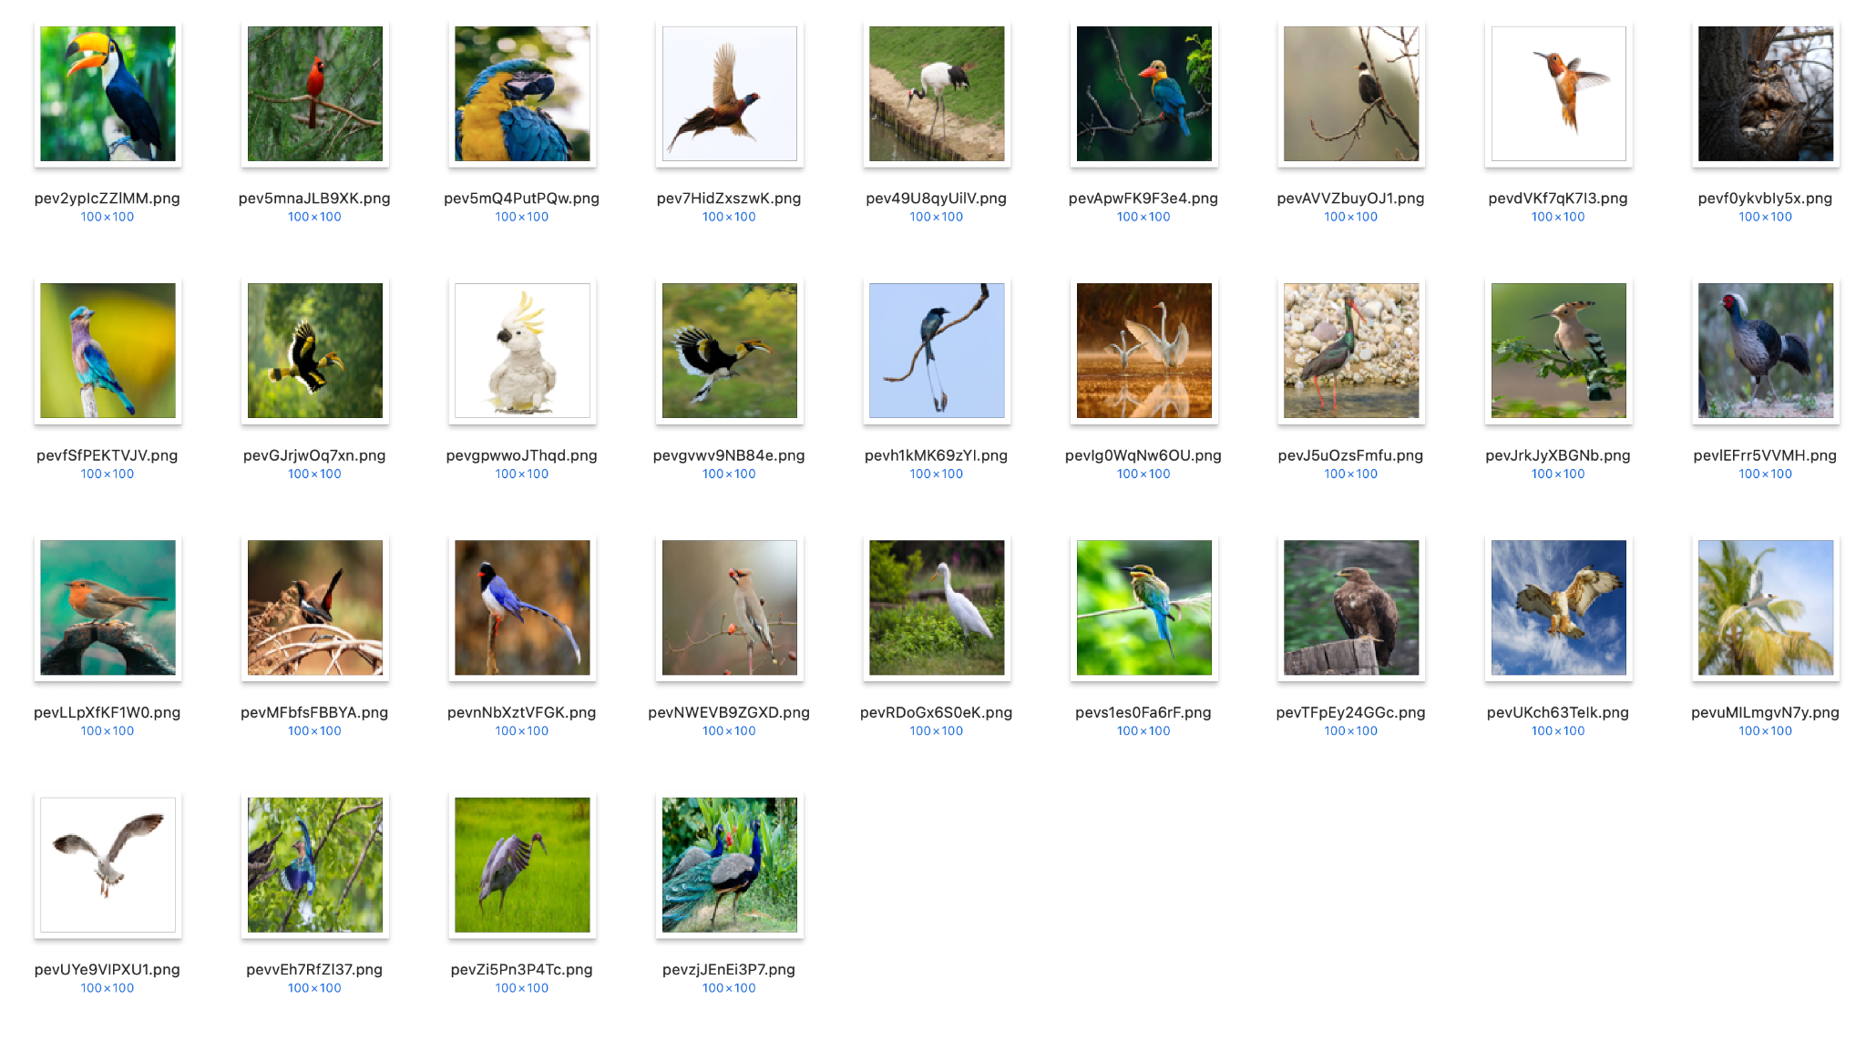
DEEP IMAGE SEARCH Example

Slide 20
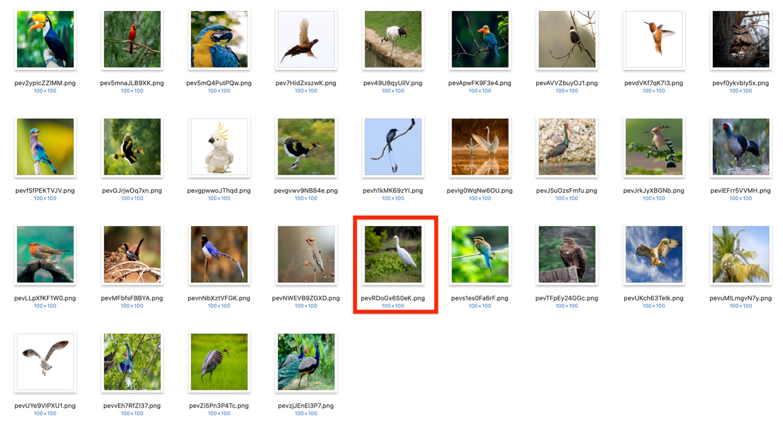
DEEP IMAGE SEARCH Example

Slide 21
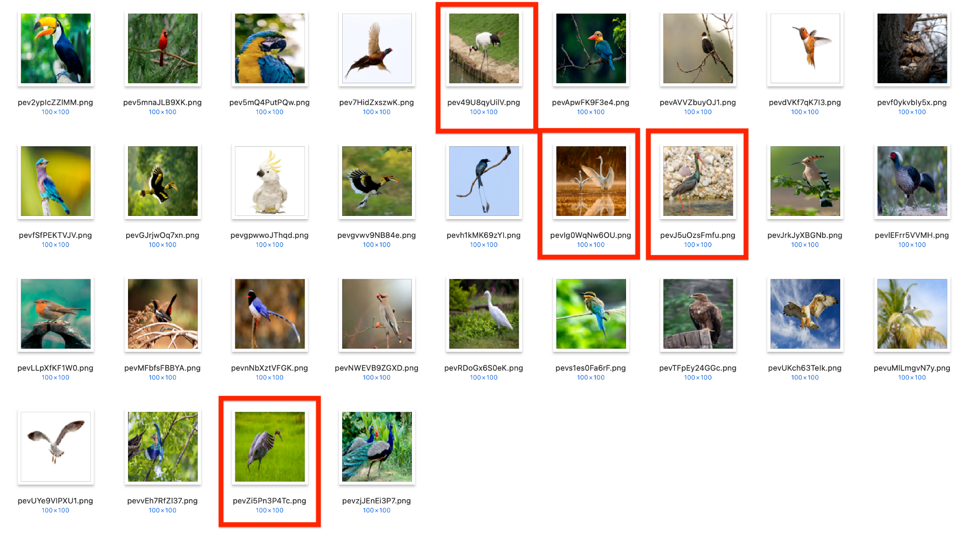
DEEP IMAGE SEARCH Example

Slide 22
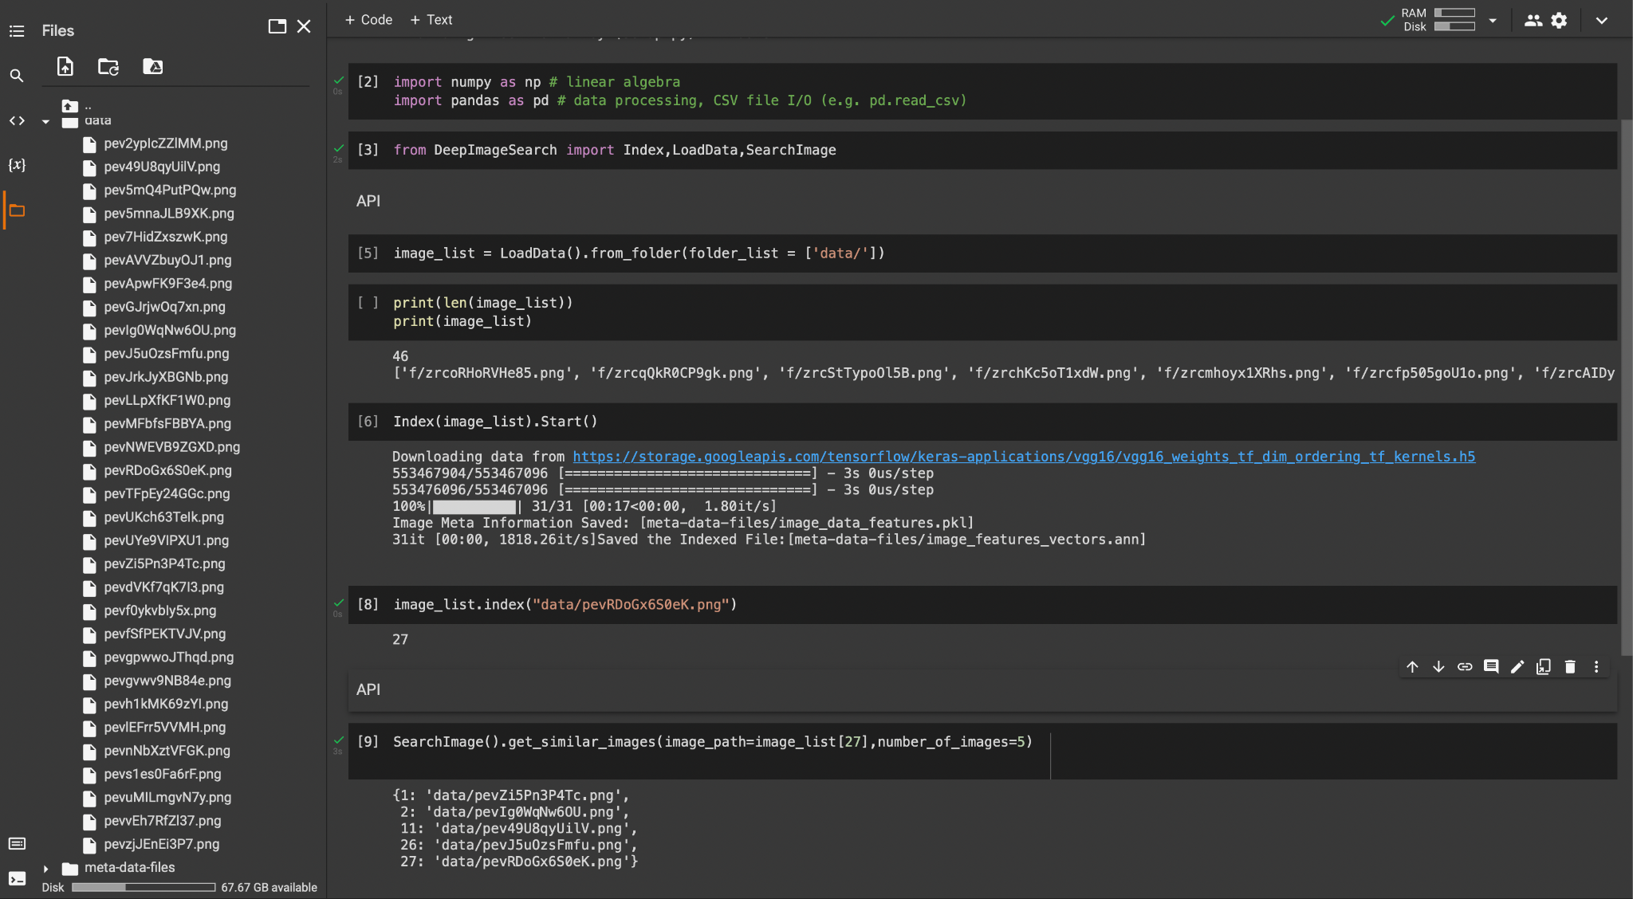
DEEP IMAGE SEARCH Code

Slide 23
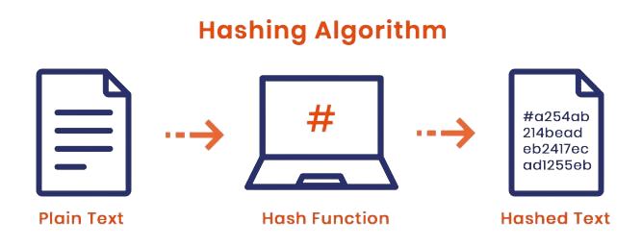
HASHING

Slide 24

HASHING

Slide 25

HASHING
(Takes RGB Values)
f9c8ff00149f08bf
Hashed Value
Image
Hashing Algo

Slide 26



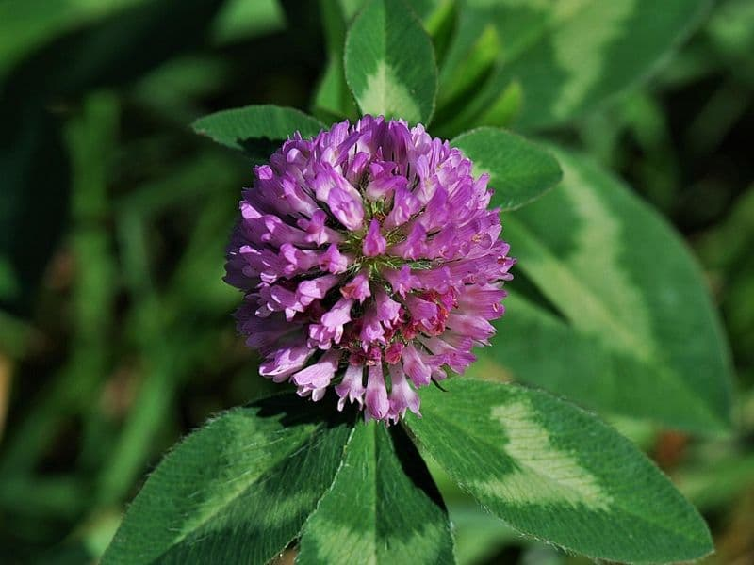

Slide 27
Hashing
First Copy
Second Copy
Similar Images

Slide 28






Hashed Value
Hashing
Hashed Value Stored In Database
$2a$10$MsZryemRW0EqWzT6J36Yp.gXZkXtwswlGgNZWApd2Cpx3qVTOHlXW
Database
Images with similar images
Stored in database
Similar images for selected images

Slide 29
Hashed value
{
$2a$10$MsZryemRW0EqWzT6J36Yp.gXZkXtwswlGgNZWApd2Cpx3qVTOHlXW
Images name Shuffled and
Stored in Database
DATABASE

Slide 30
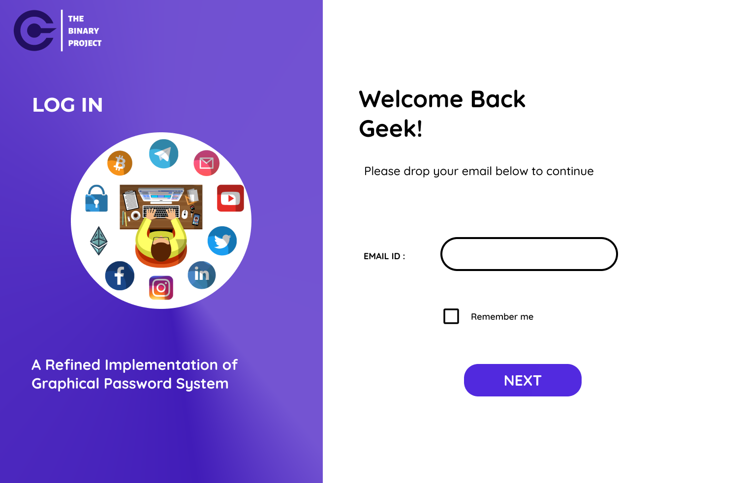
LOG IN
cyberwizard@gmail.com

Slide 31
Hashed Value
{
$2a$10$MsZryemRW0EqWzT6J36Yp.gXZkXtwswlGgNZWApd2Cpx3qVTOHlXW
cyberwizard@gmail.com
Checks for the email
in the database
DATABASE
Document Found!!
Set of images

Slide 32
DATABASE
Images Fetched into Frontend

Slide 33
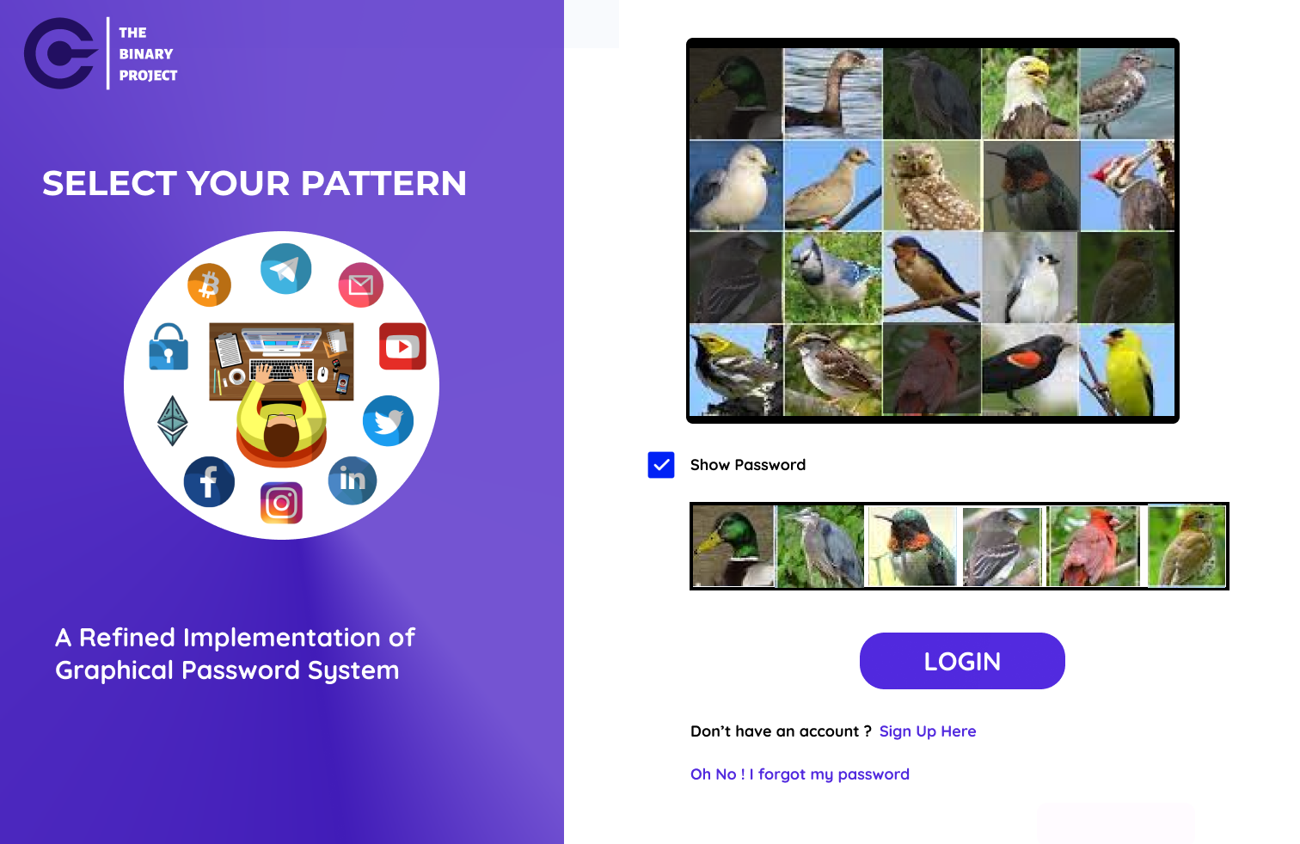
LOG IN
cyberwizard@gmail.com

Slide 34
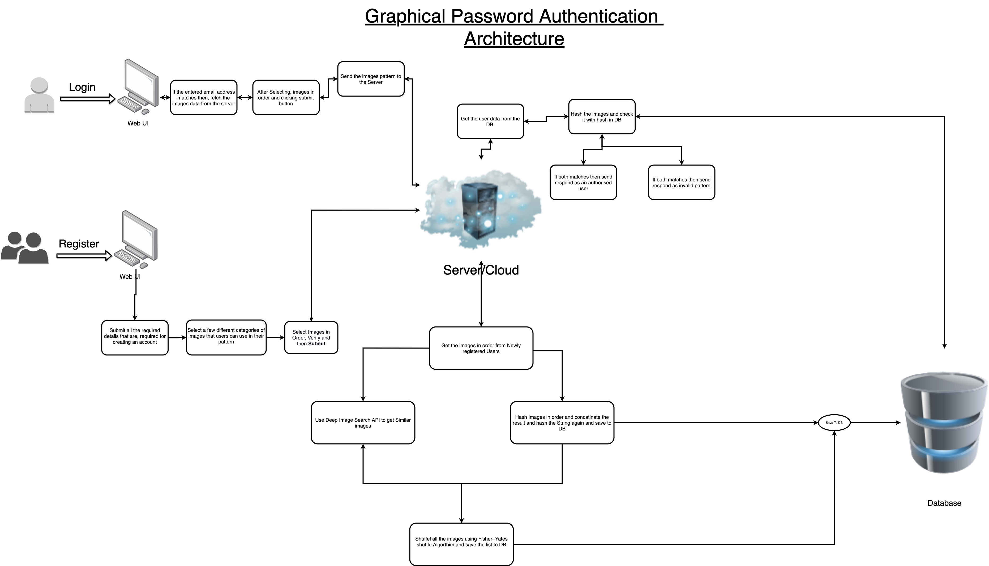

Slide 35
THANK YOU!

